Slide 1


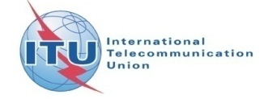
Cloud Security
Workshop on
“Cloud Computing in Arab Region”
(Muscat, Oman, 29 April 2014)
Abdelaziz Ben Aziza
Cloud Services Division Manager
Tunisia Telecom

Slide 2
Agenda
The Cloud security challenge
Security in the Cloud reference architecture
Cloud security concerns and risk issues
Cloud security requirements
Cloud Security Standards and Frameworks

Slide 3
The Cloud security challenge (1/4)
Is there any risk of loss of data stored on the Cloud? Is there a risk of hacking?
What are the precautions to physically secure my resources in the Cloud? What can I do or what can I ask my Cloud provider?
Can I ensure that the service provided by the Cloud provider will be always accessible?
What to do if a vulnerability is discovered in the Cloud?
In a Public Cloud, how to share the resources, data, applications between multiple clients hosted on the same physical infrastructure?
Who has access to the password that the client uses for the cloud services? Who has the administrative rights?
Who is legally responsible for the security and the confidentiality of data in the Cloud?
What is happening when updating a software or a firmware by the provider?
Can my data be deleted when I change a Cloud provider?
→ Loss of control, lack of trust & multi-tenancy

Slide 4
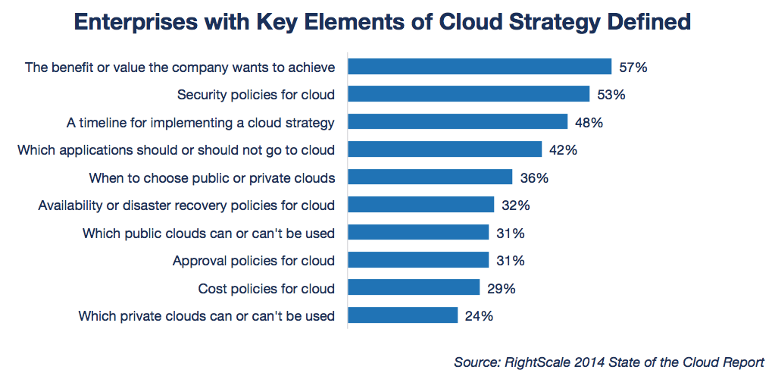
The Cloud security challenge (2/4)
While enterprises are progressing in cloud adoption, they often have yet to define key elements of their cloud strategy. Just over half of enterprises have defined the business value they want to get from cloud initiatives and security policies for cloud.

Slide 5
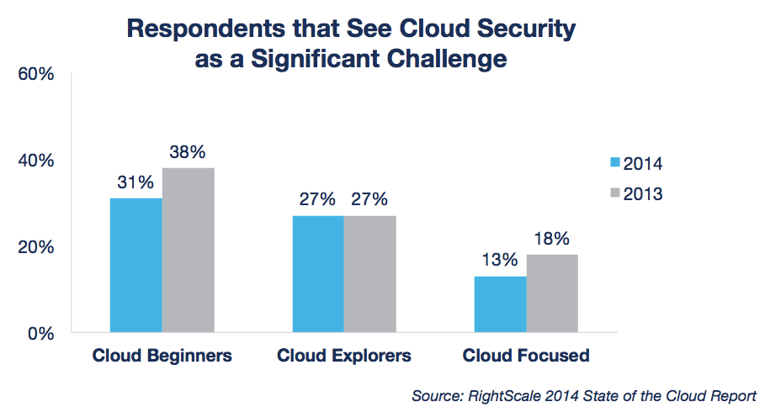
The Cloud security challenge (3/4)
Security remains the most-often cited challenge among Cloud Beginners (31%) but decreases among Cloud Focused organizations. As organizations become more experienced in Cloud, the less of a concern cloud security becomes.

Slide 6
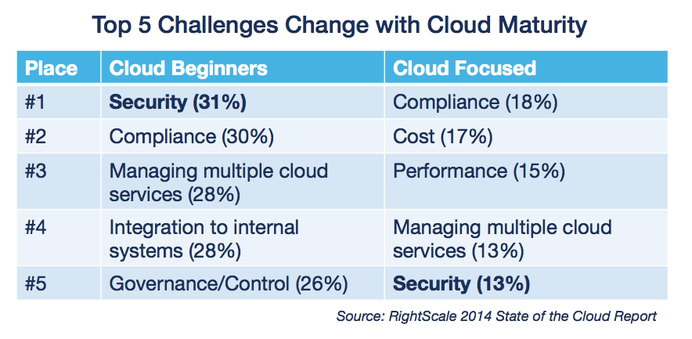
The Cloud security challenge (4/4)
While the challenge of Cloud security declines with Cloud maturity, other challenges demand attention in Cloud Focused organizations. Compliance continues to be an issue for Cloud Focused users, representing the largest challenge.

Slide 7
Security in the Cloud reference architecture (1/3)
Muscat, Oman, 29 April 2014

Slide 8
Security in the Cloud reference architecture (2/3)
Muscat, Oman, 29 April 2014

Slide 9
Security in the Cloud reference architecture (3/3)
Security and privacy are considered as cross-layer functions that cover all the layers.
Cloud security and privacy refer to the functions responsible for applying security related controls to mitigate the potential threats in cloud computing environments.
Secure functions are required by both Cloud Service Users (CSU) and Cloud Service Provider (CSP) to create a secure cloud environment
From the security perspective, the principal of separation requires each layer to take charge of certain responsibilities. In the event that the security controls of one layer are bypassed, other security functions could compensate and thus should be implemented either in other layers or as cross-layer functions.

Slide 10
Cloud security concerns and risk issues (1/3)
Responsibility ambiguity: The lack of a clear definition of responsibility among CSU and CSP may evoke conceptual conflicts. Moreover, any contractual inconsistency of provided services could induce an anomaly or incidents. However, the problem of which entity is the data controller and which one is the data processor, stays open at an international scale.
Cloud Provider viability: Since CSP are relatively new to the business, there are questions about provider viability and commitment. This concern deepens when a provider requires tenants to use proprietary interfaces leading to CSU lock-in.
Transparency: CSP does not expose details of their internal policy or technology implementation. CSUs require some transparency by providers as to provide cloud security, privacy, and how incidents are managed.
Business Continuity: CSUs require confidence that their operations and services will continue if the CSP production environment is subject to a disaster.
Security Incidents: CSUs need to be appropriately informed by the CSP when an incident occurs. CSUs may require provider support to respond to audit or assessment findings.

Slide 11
Cloud security concerns and risk issues (2/3)
Loss of physical control: Since CSU lose physical control over their data and applications, this results in a range of concerns (Privacy and Data & Control over Data)
Network availability: The value of cloud computing can only be realized when your network connectivity and bandwidth meet your minimum needs: The cloud must be available whenever you need it. If it is not, then the consequences are no different than a denial-of-service situation.
New risks, new vulnerabilities: There is some concern that cloud computing brings new classes of risks and vulnerabilities. Although all software, hardware, and networking equipment are subject to unearthing of new vulnerabilities.
Legal and Regulatory Compliance: It may be difficult or unrealistic to utilize public clouds if the data you need to process is subject to legal restrictions or regulatory compliance.
Main concern → CSU must delegate Control and Visibility to CSP.

Slide 12
Cloud security concerns and risk issues (3/3)
Threats for CSU
  Responsibility ambiguity
  Loss of governance
  Loss of trust
  CSP lock-in
  Insecure customer access
  Lack of information/asset management
  Data loss and leakage
Threats for CSP
  Responsibility ambiguity
  Protection inconsistency
  Evolutional risks
  Business discontinuity
  Supplier lock-in
  License risks
  Bylaw conflict
  Bad integration
  Insecure administration API
  Shared environment
  Hypervisor isolation failure
  Data unreliability
  Abuse right of CSP

Slide 13
Cloud security requirements (1/7)
Physical security
Data Center Facilities
CSP are generally aware to secure their Data Center and to improve the availability of deployed facilities according to the related standards and best practices (ANSI/TIA-942). The site design and the facilities infrastructure (Building, Power, cooling…) can be certified from the Uptime Institute (TIER Classification).
Physical access control and traceability
The access control is the critical physical security issue. CSU need to be sure that that good access practices are implemented in the service provider Data Center.
Hardware redundancy
The Cloud physical architecture (Network, Computing & Storage) must guarantee the high availability and the optimal performance of cloud services.
Hardware or link redundancy and replication configuration between equipment can facilitate the proper management of redundancy and increase the service availability.

Slide 14
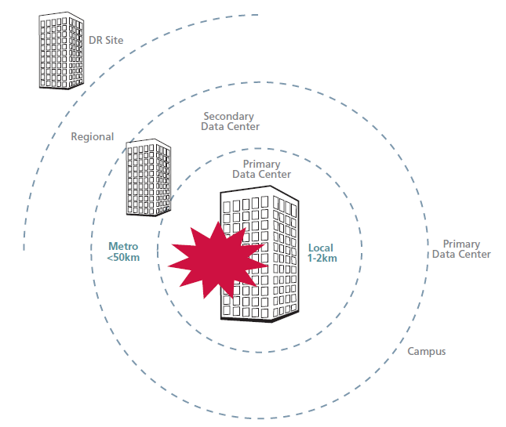
Cloud security requirements (2/7)
Physical security
Multi-site Data Center: The capability to respond to catastrophic disasters and to recover to a safe state via multi-hop Data Centers

Slide 15
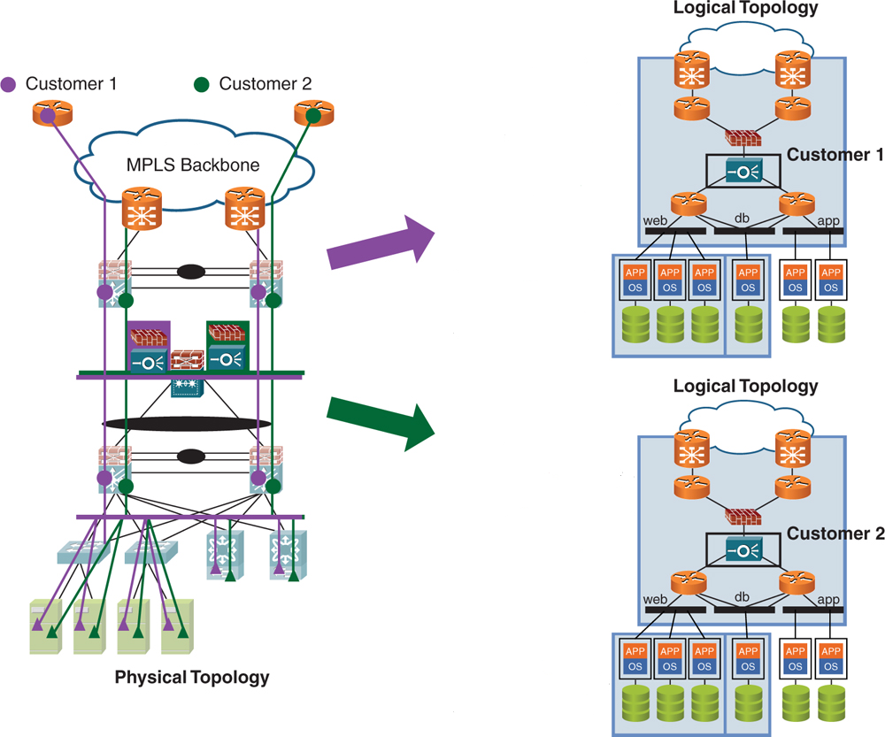
Cloud security requirements (3/7)
Logical Security
Multi-tenancy isolation & virtualization

Slide 16
Cloud security requirements (4/7)
Logical Security
Virtual Server Security
System security: security update, hypervisor cluster for automatic VM migration, reducing attack surfaces, respect the recommendation of the hypervisor (Microsoft, VMware, Citrix…)
Isolation: isolation of network flows, insolation of VM by security level, delegation of the administration.
Network segmentation
The network segmentation of virtual machines (VM) must deal with traditional risk of any server. The CSP must apply the same rules in virtualization as in a physical architecture (Edge layer, application layer, Data Base layer…) using firewall, reverse proxy…
Cloud Portal security: “Always Up”
Preventive solutions by the deployment of filtering equipment (firewall, proxy, IPS / IDS sensors ...) and antivirus solutions in order to control the legitimacy of incoming requests and guarantee the hosted data integrity.
Regular tests of vulnerabilities and intrusions. Source code audit and data control..

Slide 17
Cloud security requirements (5/7)
Data Security
Legal responsibility for data security and privacy
The CSU is legally responsible for its data and its use, including the compliance with legal obligations. The CSP is subject to technical and organizational obligations. It is committed to preserve the data integrity and privacy, including preventing access, loss, modification or destruction. The service contract must address the area of responsibility of each party.
Data Protection & Recovery
In reality, there is a delegation of responsibilities to the CSP. The SLAs is defining for each CSU the expected service levels (RTO, RPO…). The CSP is responsible to keep the infrastructure “Always On”, to protect data via the classical technologies (Backup, Snapshot…)
Data Integrity
For a secure Cloud, it is important to consider the access control by implementing the functionality "Role Based Access Control" or RBAC. It is a method which allows to define a number of actions that can make a CSU or an administrator in the Cloud.

Slide 18
Cloud security requirements (6/7)
Data Security
Data Encryption
The challenges of cryptography in the cloud are complex, especially when it comes to protecting the hosted data against unauthorized access of the CSP. Work is underway at the major CSPs to implementation an encryption suitable for these situations and provide a good balance between safety, efficiency and functionality.
Data Traceability
At any given time, a cloud service provider should know exactly where both user data and VMs data are stored, processed, or accessed from.
Reversibility: changing a CSP
To facilitate migration between Cloud, there are several Cloud APIs emerging on the market. APIs standardization organizations will be preferred since they begun to be used by a significant number of cloud providers. For example, SNIA's CDMI (Cloud Data Management Interface) has the objective to enable portability, compliance, data security and interoperability between different cloud providers.

Slide 19
Cloud security requirements (7/7)
Processes & procedures
Security management
Security self-assessment, and security audit/security certification by a third party, shall be established in order for a CSP to provide services based on the user's security requirements (ISO 27001, PCI DSS)
License management and jurisdictional compliance
License and intellectual property will be managed by the provider in accordance with the regional laws and regulations
Security models federation
Cloud service providers shall broker the different security connections in a manner which will enable an organization to use various cloud services together

Slide 20
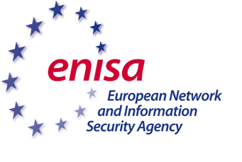
Cloud Security Standards and Frameworks (1/3)
European Union Agency for Network and Information Security (ENISA): One of the most widely-read reference documents on cloud security: “Cloud computing: benefits, risks and recommendations for information technology”, by ENISA, uses a risk-assessment approach to analyze the security issues raised by cloud services: https://www.enisa.europa.eu/
The most important results of this report are:
A prioritized list of organizational, technical, and legal risks, for clients of cloud providers (CSU).
An assurance framework allowing cloud customers to compare different providers (CSP) according to their security practices.
A comprehensive analysis of legal issues raised by cloud computing, and advice for contractual negotiations or selection of providers on the basis of their contractual conditions and proposed SLAs.

Slide 21
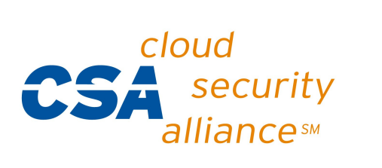
Cloud Security Standards and Frameworks (2/3)
Cloud Security Alliance (CSA) is a non-profit organization formed to promote the use of best practices for providing security assurance within cloud computing, and provide education on the uses of cloud computing to help secure all other forms of computing: https://cloudsecurityalliance.org/
CSA’s objectives are:
To promote a common level of understanding between the consumer (CSU) and the provider of cloud computing (CSP) with regard to security requirements and attestation of assurance
To promote independent research into best practices for cloud computing security
To launch awareness campaigns and educational programs on the appropriate uses of cloud computing, and cloud security solutions
To create consensus lists of issues and guidance for cloud security assurance

Slide 22

Cloud Security Standards and Frameworks (3/3)
ITU-T Study Group 17 – Security: Work to build confidence and security in the use of information and communication technologies (ICTs) continues to intensify in a bid to facilitate more secure network infrastructure, services and applications. Over seventy standards (ITU-T Recommendations) focusing on security have been published.
ITU-T SG17 coordinates security-related work across all ITU-T Study Groups. Often working in cooperation with other Standards Development Organizations (SDOs) and various ICT industry consortia, SG17 deals with a broad range of standardization issues: http://www.itu.int/en/ITU-T/studygroups/2013-2016/17/Pages/default.aspx

Slide 23
Conclusion: How to build a secure Cloud?
Cloud is a natural evolution in the ICT world
Security in an essential requirement. In developing solutions to cloud computing security issues, it may be helpful to identify the problems and approaches in terms of:
  Loss of control
  Lack of trust
  Multi-tenancy problems
To fully enjoy the benefits of Cloud, we need a clear, dynamic, effective and coherent regulation which guarantees data transparency, protection and integrity. This regulation should encourage innovation, investment and competition in term of cloud services while protecting the interests of the Cloud consumers.

Slide 24


Thank you...
Abdelaziz.benaziza@gmail.com
@abenaziza

